Slide 1
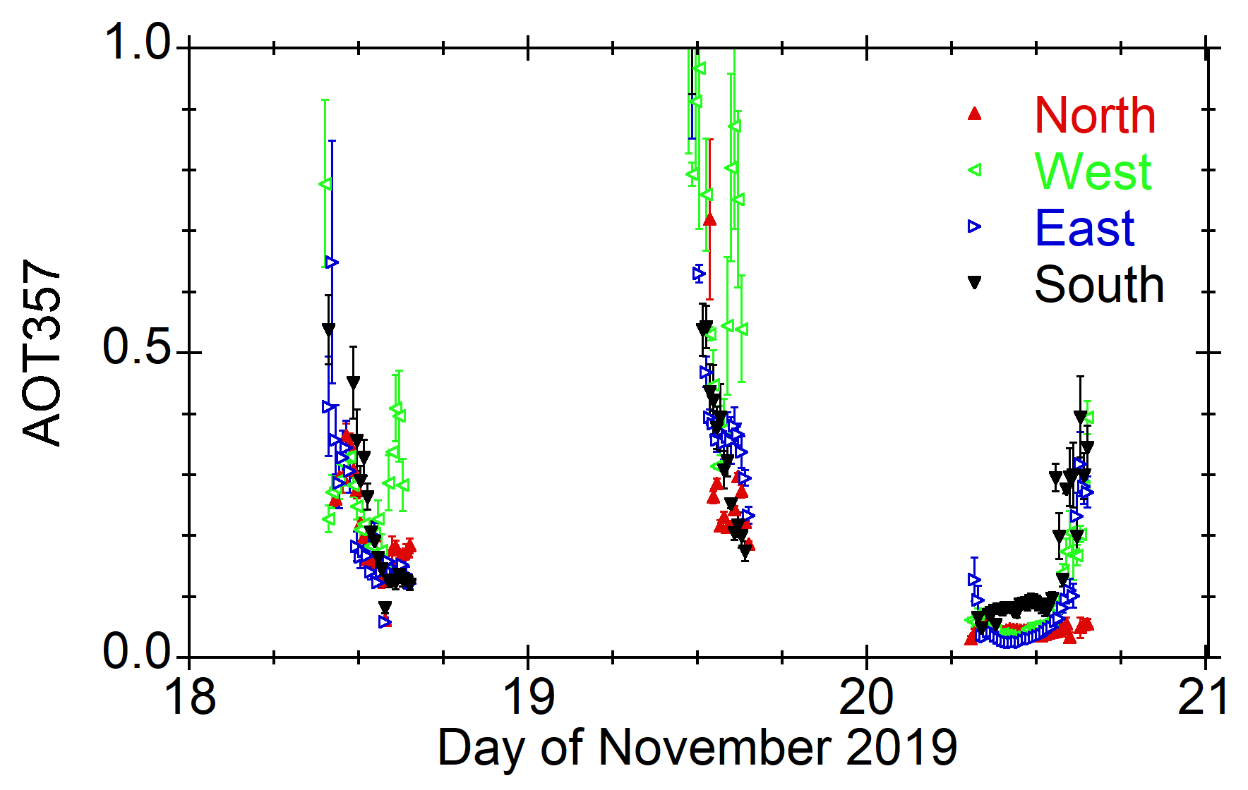
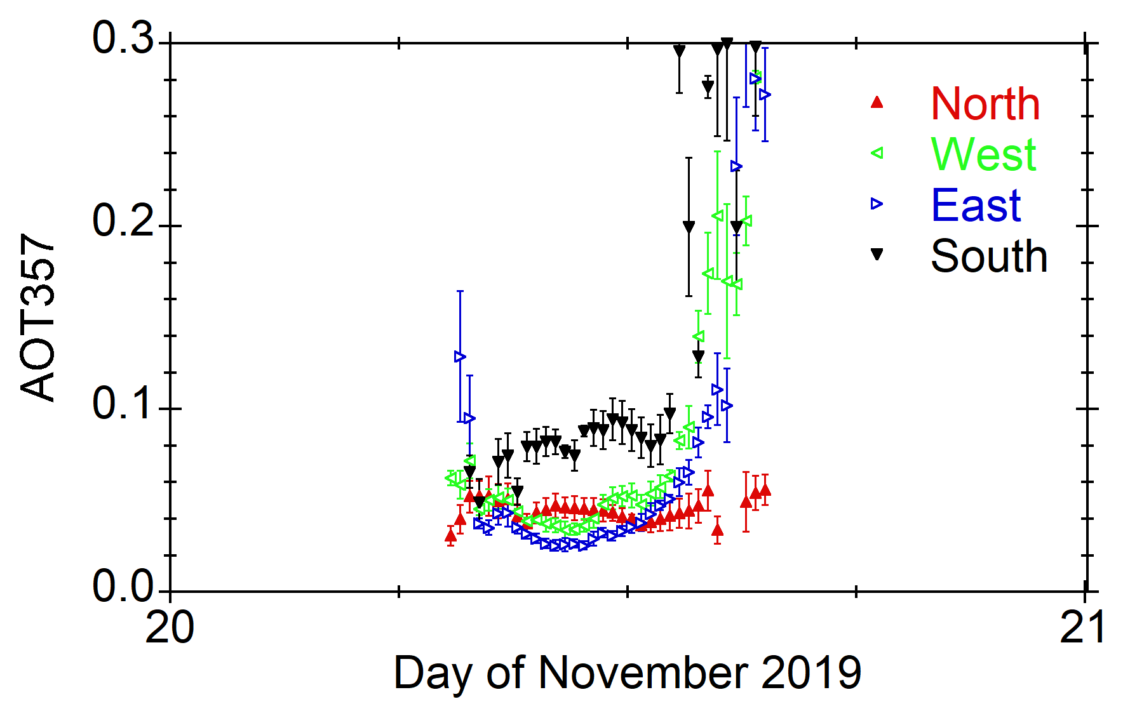
Spatial distribution of AOT
observed by 4AZ-MAXDOAS
On Nov. 20, AOT at south direction was likely high compared to those at other directions.

Slide 2
Spatial distribution of NO₂
observed by 4AZ-MAXDOAS
Yonekawa-kun’s result
NO₂ at south direction was also high compared to those at other directions.

Slide 3
AOT comparison
SKYNET vs. AERONET
Kobayashi-kun’s result
Expected good agreement within ~0.01.
SKYNET AOT tends to be smaller than AERONET AOT, but the tendency can be explained by spatial distribution of AOT seen by MAX-DOAS.
※AERONET data for south (pointing to the sun), SKYNET for south + other directions (scanning)

